Slide 1
T3/Tutorials: Data Submission
Uploading genotype experiments
https://triticeaetoolbox.org/

Slide 2
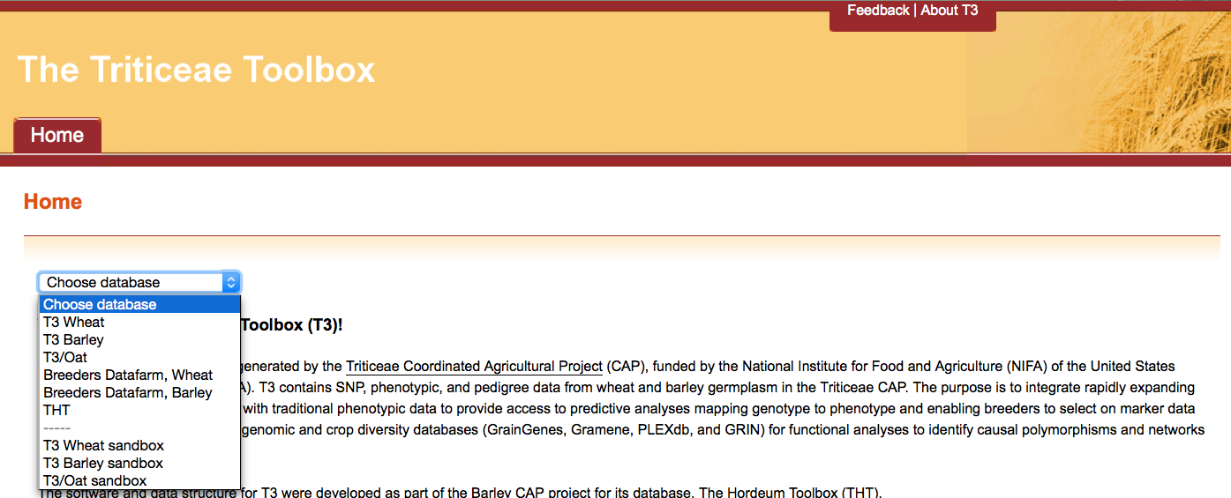
The Triticeae Toolbox (T3)
Each of the T3 databases can be reached from the T3 homepage: https://triticeaetoolbox.org/
T3/Wheat will be used for demonstration purposes but these instructions are applicable to each instance of T3

Slide 3
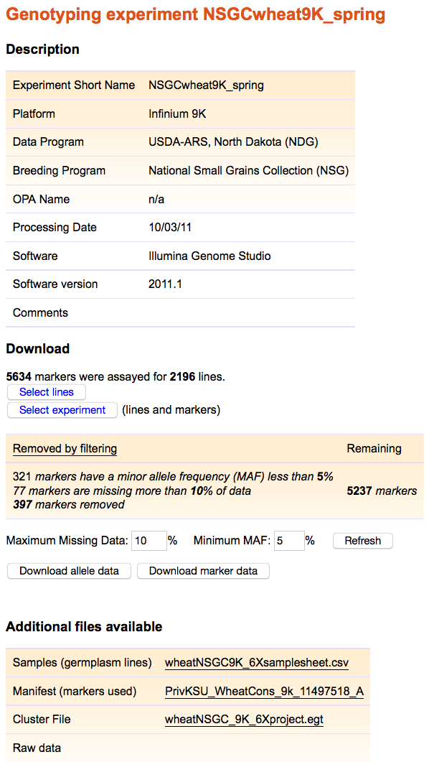
T3 genotype trial reports
The experiment name is the unique identifier for a T3 genotype experiment
The experiment description is loaded first
A line translation file must then be loaded, which links existing T3 lines to the genotype experiment
Genotype data can then be uploaded in one of four formats
Supplemental data files can also be attached to the genotype experiment
1
2
3
4

Slide 4
Uploading genotype experiments: Outline
Downloading the data submission templates
The experiment description template
Completing the experiment description template
Test loading the experiment description template
Completing the line translation template
Completing the genotype data template
Test loading genotype results
Submitting the completed templates for upload to T3

Slide 5
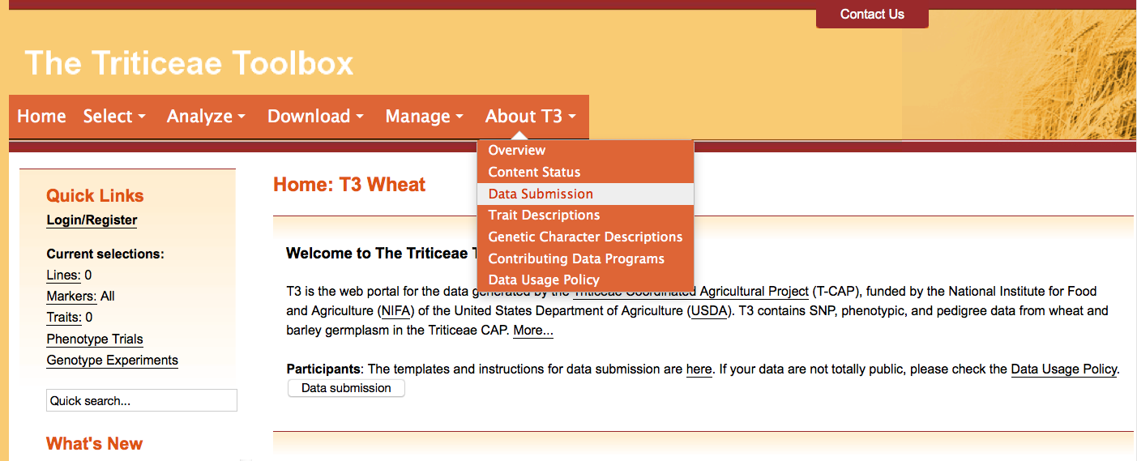
Section 1: Downloading the data submission templates
Navigate to the T3 database homepage of your choice
e.g. https://triticeaetoolbox.org/wheat/
Choose the About T3 menu > Data Submission

Slide 6
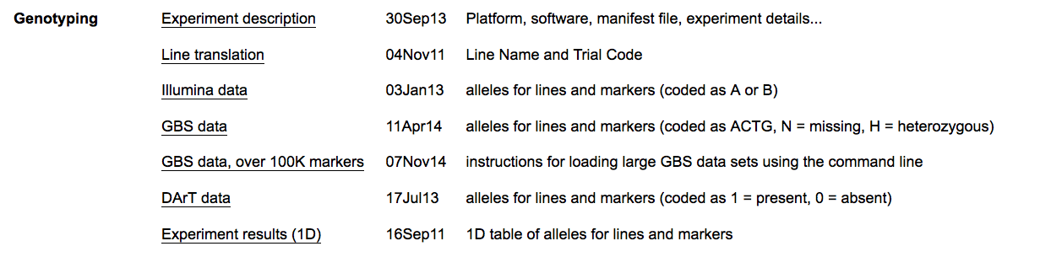
Section 1: Downloading the data submission templates
The “Genotyping” section of the “Data Submission” page contains the three templates that you need to load genotype data:
The “Experiment description” template is used to submit trial details and can be used to create a new trial record or to update existing genotype trial information in T3
The “Line translation” template links the T3 lines that were genotyped in the trial to the genotype trial name
The genotype data is loaded using either the “Illumina data”, “GBS data” or “DArT data” template, or as a 1D table of alleles

Slide 7
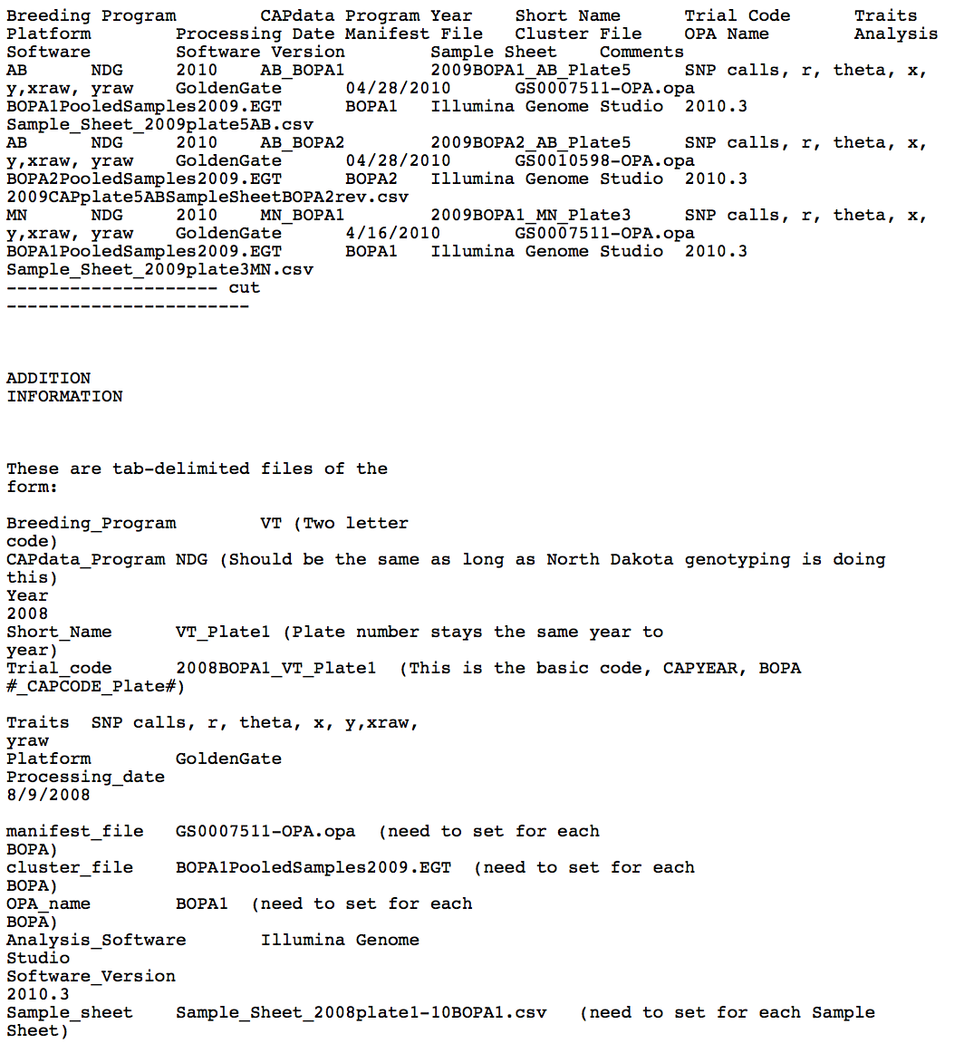
Section 1: Downloading the data submission templates
Each of the “Genotyping” template links will take you to a webpage that displays the template
Right click the link and “Save Link As…” to store the text file to your computer
The templates are in .txt format
This tutorial will use Excel to display the text files

Slide 8
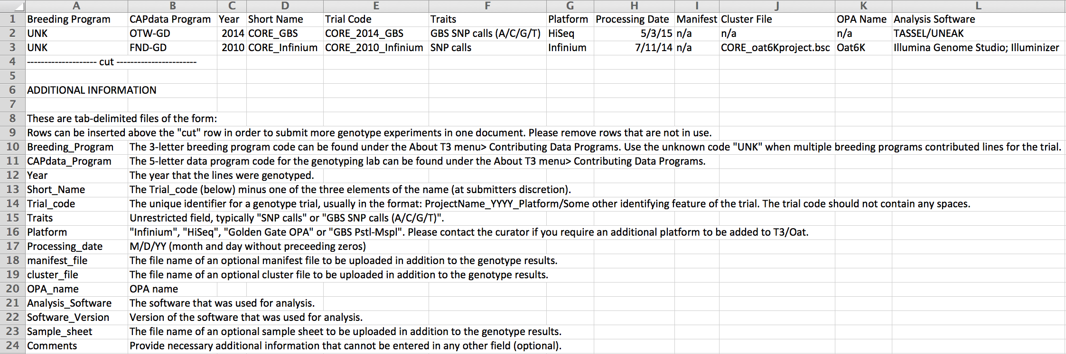
Section 2.1: Completing the experiment description template
The notes section contains most of the information needed to fill out the experiment description template apart from the:
Breeding program codes
This information can be found under the “About T3” menu

Slide 9
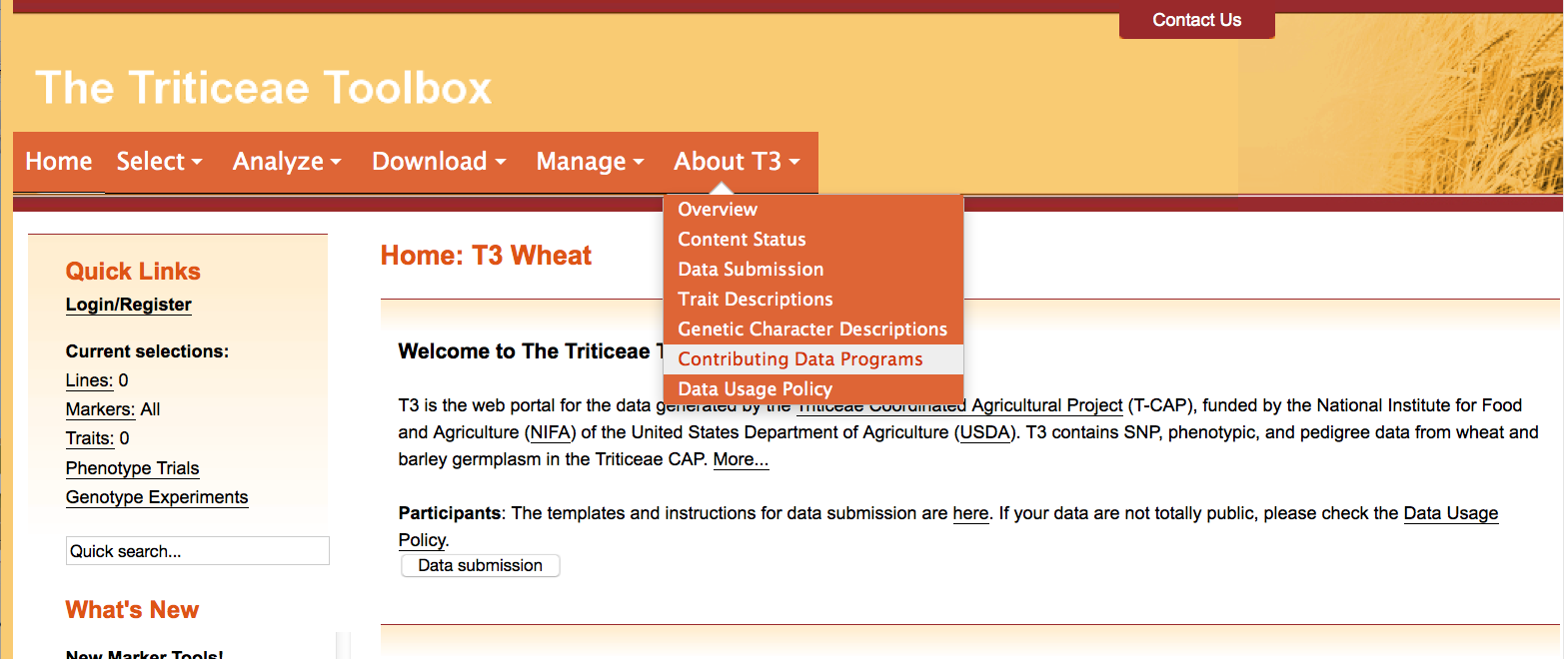
Section 2.1: Completing the experiment description template
To find the breeding program codes
Choose the About T3 menu > Contributing Data Programs

Slide 10
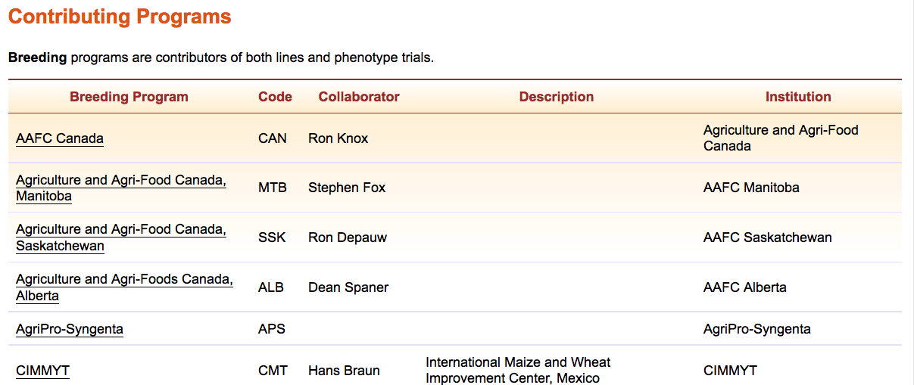
Section 2.1: Completing the experiment description template
Breeding program codes can be found in the second column of the table on the “Contributing Programs” page
Contact the curator if you do not find an appropriate code

Slide 11
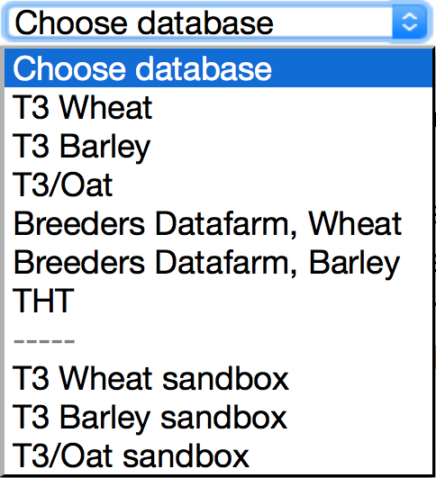
Section 2.2: Test-loading the experiment description template
Each T3 database has a corresponding “sandbox”
Registered users can test-load data in these sandboxes
Data that is successfully uploaded to a sandbox can be submitted to the curator to be uploaded to the related production database
The production databases are the official repositories of T3 data
The sandboxes revert to an exact copy of the production databases each night

Slide 12
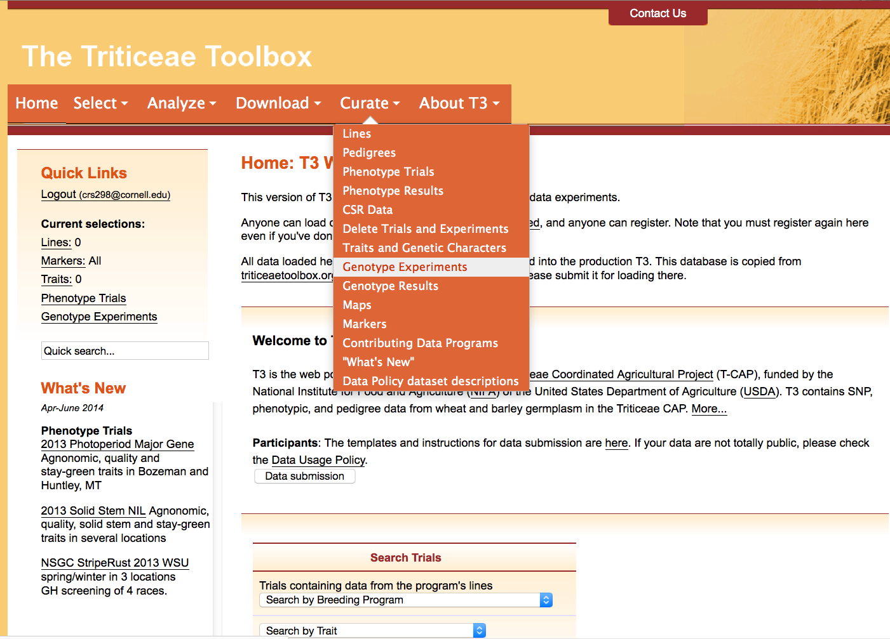
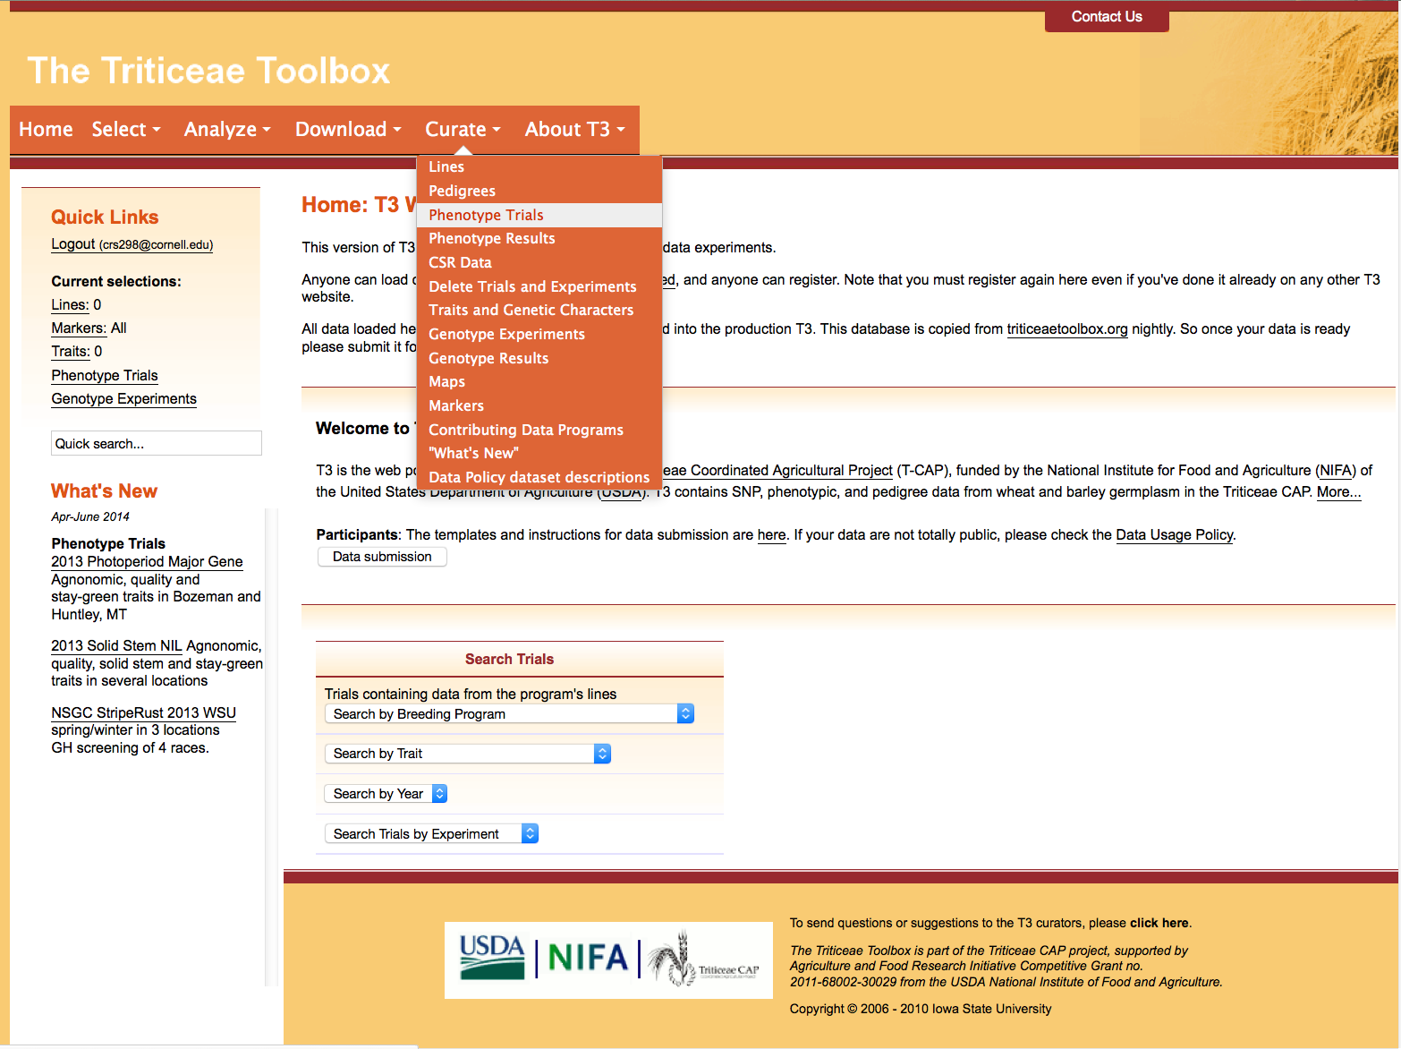
Section 2.2: Test-loading the experiment description template
Navigate to the crop-specific T3 sandbox of your choice
e.g. https://t3sandbox.org/t3/sandbox/wheat/
The curation menu will appear once you register and login
Choose the Curate menu > Genotype Experiments

Slide 13
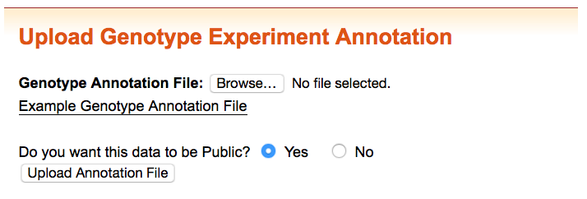
Section 2.2: Test-loading the experiment description template
Select the completed trial description template to test-load it in the sandbox
It is possible to upload “private data” to T3
Private data is only visible to users that are designated as collaborators by the site administrators
Data may remain private for a limited time only
Please contact the curator if you are interested in this option

Slide 14
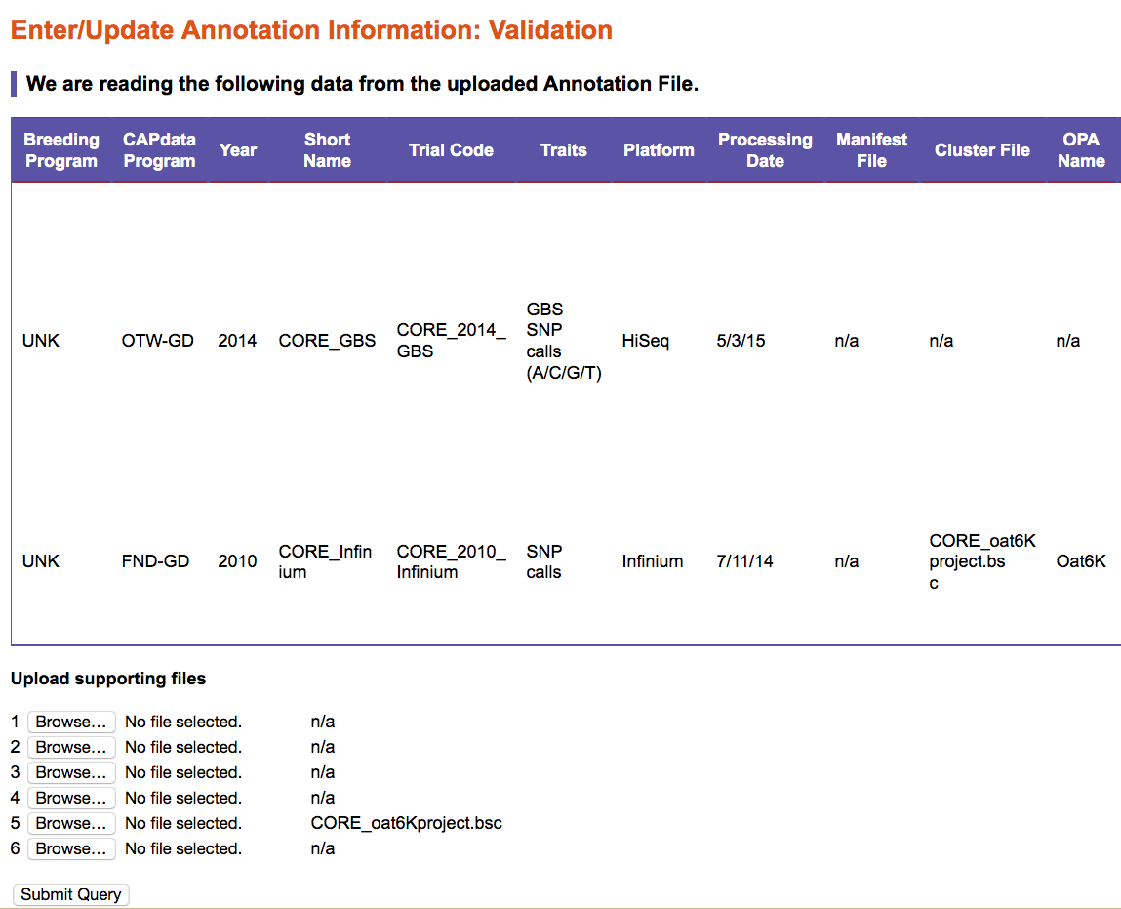
Section 2.2: Test-loading the experiment description template
The validation window shows how T3 has read the upload document
Please take the time to validate your data
Attach any available supporting documents
Remember to attach a manifest file, cluster file or sample sheet if you referred to them in the experiment description
Additional supporting files can be loaded at your discretion
Don’t forget to “Submit” the upload if the information is correct.

Slide 15
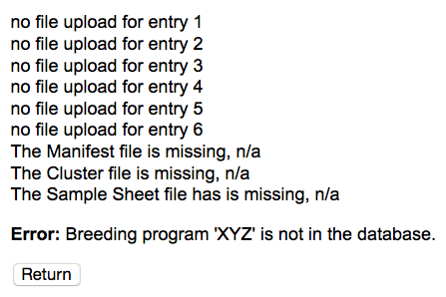
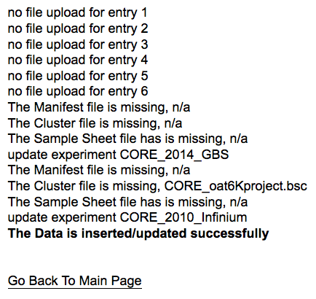
Section 2.2: Test-loading the experiment description template
It is OK to have a “missing” manifest file, cluster file or sample sheet if those files are unavailable to you
Any illegal entries will be highlighted at this stage
e.g. invalid breeding program code
Fix illegal entries in your upload document and re-submit it
Once your experiment description has loaded successfully you can upload the:
Line translation file
Genotype data file
These files are uploaded at the same time

Slide 16
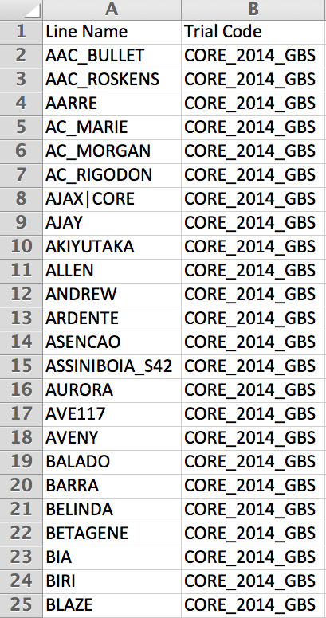
Section 4: Completing the line translation template
The line translation file links existing T3 line records to the genotype trial
The first column should contain the names of genotyped lines as they appear in T3
The second column should contain the trial code that was created in the experiment description upload document repeated for every line
Please refer to the T3 line submission tutorial for instructions on how to:
Correctly format line names for T3
Search for existing line records by line name, using the “Select Lines by Properties” tool
Add new line records to T3

Slide 17
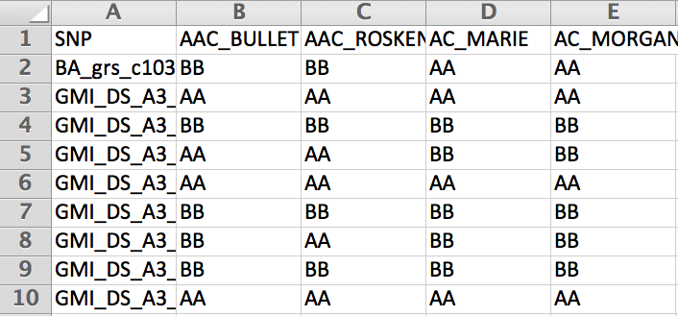
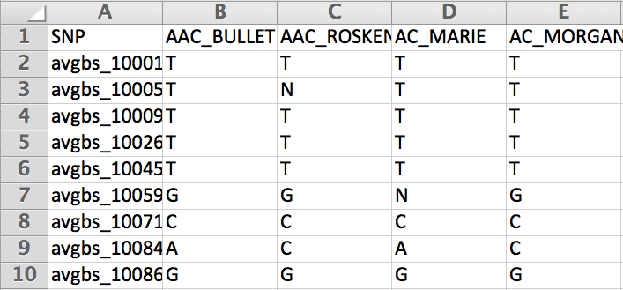
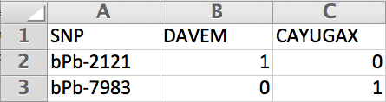
Section 5: Completing the genotype data template
Illumina data template
Genotype data can be loaded as:
Illumina data
Alleles coded as A or B
GBS data
Alleles coded ACTG
N= missing
H= heterozygous
DArT data
Alleles coded as 1 (present) or 0 (absent)
1D table of alleles for lines and markers (not shown)
In cases 1-3, the first column should contain the T3 marker names and the first row should contain the T3 line names.
GBS data template
DArT data template

Slide 18
Section 5: Completing the genotype data template
Illumina data template
The line names used in the genotype data submission document must match the line names in the related line translation document
All lines and markers in the submission documents must already be present in T3
Please refer to the T3 marker upload tutorial for instructions on how to:
Search for existing marker records using the “Select Markers” tool
Add new marker records to T3
GBS data template
DArT data template

Slide 19
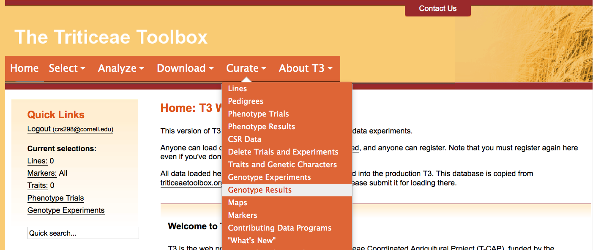
Section 6: Test loading genotype results
Navigate to the crop-specific T3 sandbox of your choice
e.g. https://t3sandbox.org/t3/sandbox/wheat/
The curation menu will appear once you register and login
Choose the Curate menu > Genotype Results

Slide 20
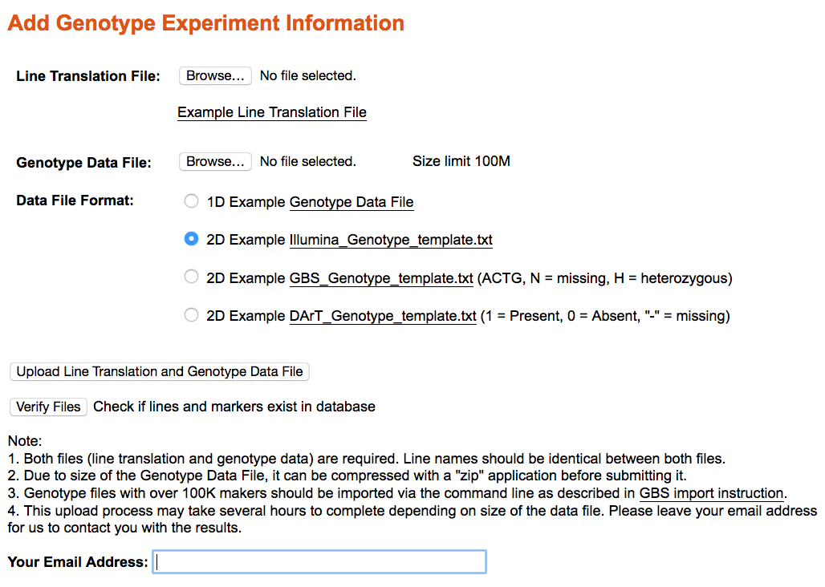
Section 6: Test loading genotype results
Attach your completed line translation file…
Attach your results file and select which of the genotype data templates you used…
You’ll receive an email when your upload was successful (or an email telling you why it was not)

Slide 21
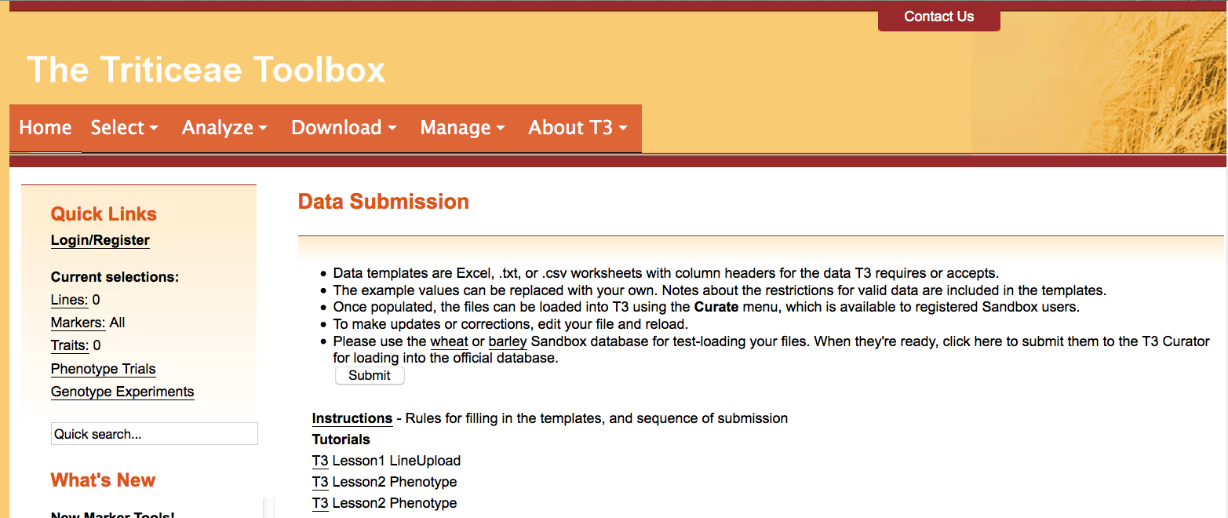
Section 7: Submitting the completed templates to T3
Finally, submit your documents to the curator for upload to T3
Login and then navigate to the “Data Submission” page
Click the “Submit” button

Slide 22
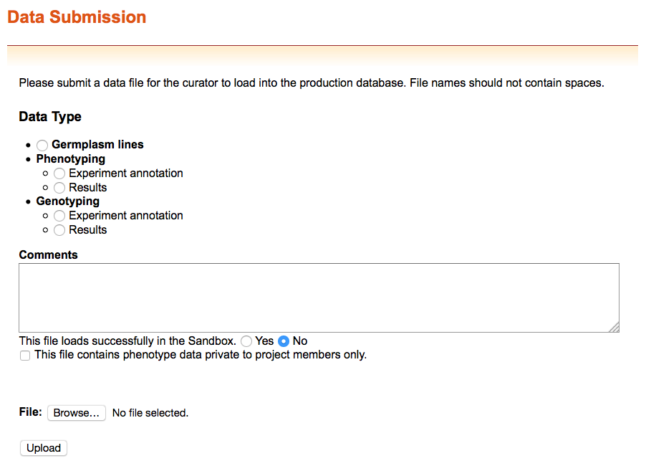
Section 7: Submitting the completed templates to T3
You can submit files that do not successfully upload to the sandbox to receive help from the curator

Slide 23
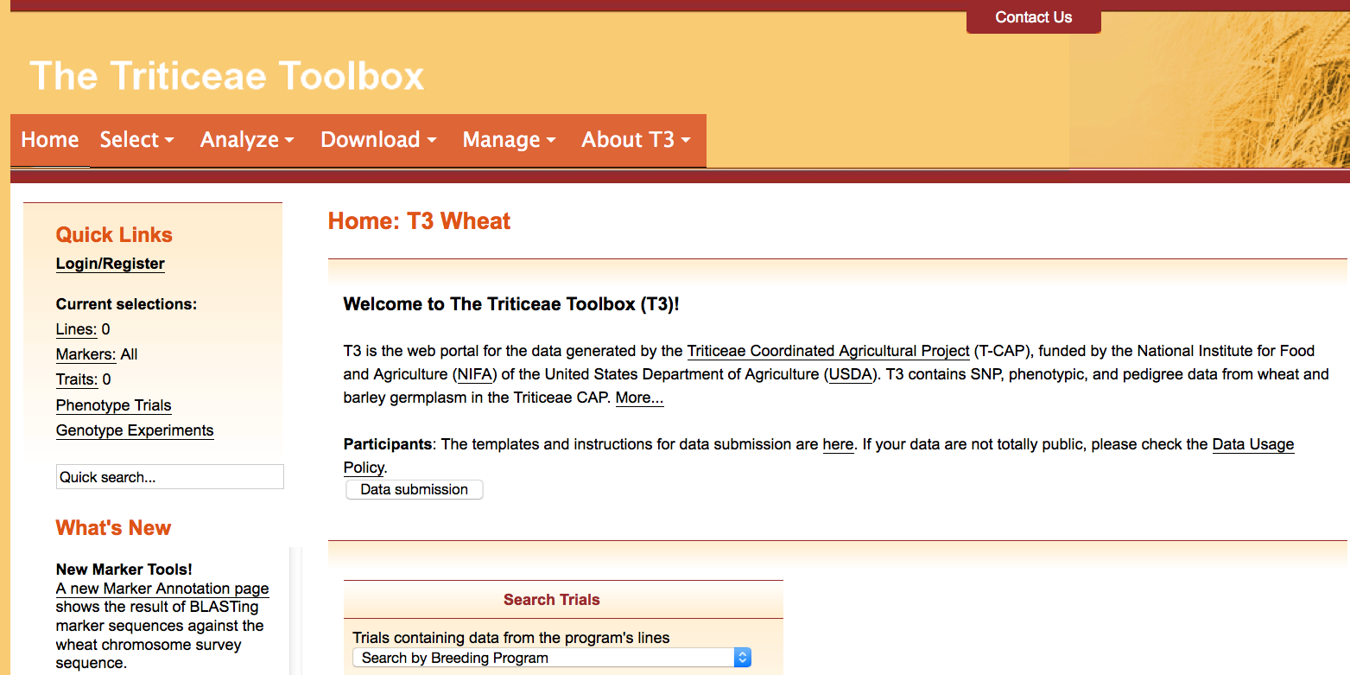
Contact Us
Please contact us if you need help using T3

